Slide 1
Semi Supervised Learning,

Slide 2
Semi Supervised Learning
Semi-supervised learning (SSL) is a machine learning technique that uses both labeled and unlabeled data to train AI models for classification and regression.
SSL is a combination of supervised and unsupervised learning, and it uses techniques that incorporate unlabeled data into model training.

Slide 3
Examples of Semi-Supervised Learning
Text Classification
Image Classification
Anomaly Detection

Slide 4
Reinforcement Learning
Reinforcement learning (RL) is a machine learning (ML) technique that trains software to make decisions to achieve the most optimal results.
Reinforcement Learning is a feedback-based Machine learning technique in which an agent learns to behave in an environment by performing the actions and seeing the results of actions.
Reinforcement learning is a form of machine learning that teaches a model to choose the best course of action while solving a problem
It mimics the trial-and-error learning process that humans use to achieve their goals.
Reinforcement Learning (RL) is the science of decision making. It is about learning the optimal behavior in an environment to obtain maximum reward.

Slide 5
In Reinforcement Learning, the agent learns automatically using feedbacks without any labeled data, unlike supervised learning.
Since there is no labeled data, so the agent is bound to learn by its experience only.
How a Robotic dog learns the movement of his arms is an example of Reinforcement learning.

Slide 6
Types of Reinforcement:
There are two types of Reinforcement:
Positive: Positive Reinforcement is defined as when an event, occurs due to a particular behavior, increases the strength and the frequency of the behavior. In other words, it has a positive effect on behavior.
Advantages of reinforcement learning are:
Maximizes Performance
Sustain Change for a long period of time
Too much Reinforcement can lead to an overload of states which can diminish the results

Slide 7
Types of Reinforcement:
Negative: Negative Reinforcement is defined as strengthening of behavior because a negative condition is stopped or avoided.
Advantages of reinforcement learning:
Increases Behavior
Provide defiance to a minimum standard of performance
It Only provides enough to meet up the minimum behavior

Slide 8
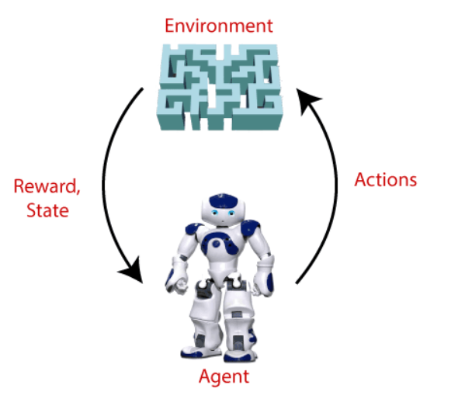

Slide 9
Example: Suppose there is an AI agent present within a maze environment, and his goal is to find the diamond. The agent interacts with the environment by performing some actions, and based on those actions, the state of the agent gets changed, and it also receives a reward or penalty as feedback.
The agent continues doing these three things (take action, change state/remain in the same state, and get feedback), and by doing these actions, he learns and explores the environment.
The agent learns that what actions lead to positive feedback or rewards and what actions lead to negative feedback penalty. As a positive reward, the agent gets a positive point, and as a penalty, it gets a negative point

Slide 10
Markov Decision Process
Markov Decision Process or MDP, is used to formalize the reinforcement learning problems.
If the environment is completely observable, then its dynamic can be modeled as a Markov Process.
In MDP, the agent constantly interacts with the environment and performs actions; at each action, the environment responds and generates a new state.

Slide 11
A State is a set of tokens that represent every state that the agent can be in.
MDP contains a tuple of four elements (S, A, P_{a}, R_{a}):
A set of finite States S
A set of finite Actions A
Rewards received after transitioning from state S to state S', due to action a.
Probability P_{a}.

Slide 12
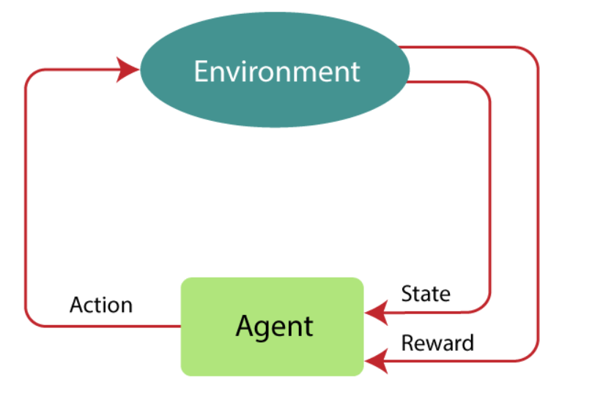

Slide 13
Markov Property
MDP uses Markov property, and to better understand the MDP, we need to learn about it.
"If the agent is present in the current state S1, performs an action a1 and move to the state s2, then the state transition from s1 to s2 only depends on the current state and future action and states do not depend on past actions, rewards, or states.“
Example: Chess game, the players only focus on the current state and do not need to remember past actions or states.

Slide 14
Markov Process is a memoryless process with a sequence of random states S₁, S₂, ....., S_{t} that uses the Markov Property. Markov process is also known as Markov chain, which is a tuple (S, P) on state S and transition function P.

Slide 15
Bellman Equation
The Bellman equation was introduced by the Mathematician Richard Ernest Bellman in the year 1953, and hence it is called as a Bellman equation.
It is associated with dynamic programming and used to calculate the values of a decision problem at a certain point by including the values of previous states.

Slide 16

Where,
V(s)= value calculated at a particular point.
R(s,a) = Reward at a particular state s by performing an action a.
γ = Discount factor(Gamma)
V(s`) = The value at the previous state.

Slide 17
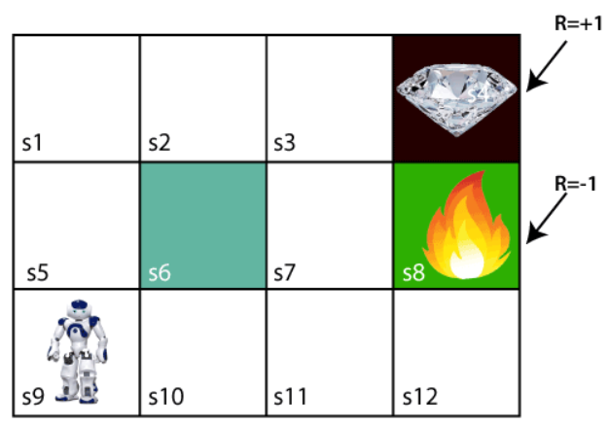

Slide 18
In the above image, the agent is at the very first block of the maze. The maze is consisting of an S₆ block, which is a wall, S₈ a fire pit, and S₄ a diamond block.
The agent cannot cross the S₆ block, as it is a solid wall. If the agent reaches the S₄ block, then get the +1 reward; if it reaches the fire pit, then gets -1 reward point. It can take four actions: move up, move down, move left, and move right.
The agent can take any path to reach to the final point, but he needs to make it in possible fewer steps. Suppose the agent considers the path S9-S5-S1-S2-S3, so he will get the +1-reward point.

Slide 19
For 1st block:
V(s3) = max [R(s,a) + γV(s`)], here V(s')= 0 because there is no further state to move.
V(s3)= max[R(s,a)]=> V(s3)= max[1]=> V(s3)= 1
For 2nd block:
V(s2) = max [R(s,a) + γV(s`)], here γ= 0.9(lets), V(s')= 1, and R(s, a)= 0, because there is no reward at this state.
V(s2)= max[0.9(1)]=> V(s)= max[0.9]=> V(s2) =0.9

Slide 20
For 3rd block:
V(s1) = max [R(s,a) + γV(s`)], here γ= 0.9(lets), V(s')= 0.9, and R(s, a)= 0, because there is no reward at this state also.
V(s1)= max[0.9(0.9)]=> V(s3)= max[0.81]=> V(s1) =0.81
For 4th block:
V(s5) = max [R(s,a) + γV(s`)], here γ= 0.9(lets), V(s')= 0.81, and R(s, a)= 0, because there is no reward at this state also.
V(s5)= max[0.9(0.81)]=> V(s5)= max[0.81]=> V(s5) =0.73

Slide 21
For 5th block:
V(s9) = max [R(s,a) + γV(s`)], here γ= 0.9(lets), V(s')= 0.73, and R(s, a)= 0, because there is no reward at this state also.
V(s9)= max[0.9(0.73)]=> V(s4)= max[0.81]=> V(s4) =0.66

Slide 22
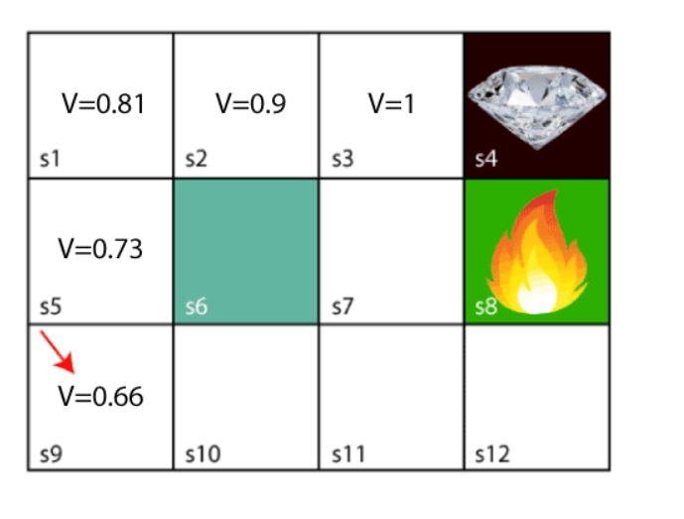

Slide 23
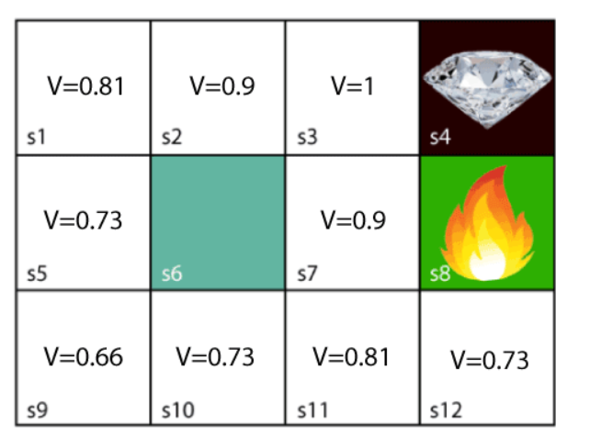

Slide 24
By using the Bellman equation our agent will calculate the value of every step except for the trophy and the fire state (V = 0), they cannot have values since they are the end of the maze.

Slide 25
Policy Evolution using Monte Carlo
Monte Carlo policy evaluation is a technique within the field of reinforcement learning that estimates the effectiveness of a policy—a strategy for making decisions in an environment.
It’s a bit like learning the rules of a game by playing it many times, rather than studying its manual.
This approach doesn’t require a pre-built model of the environment; instead, it learns exclusively from the outcomes of the episodes it experiences.

Slide 26
How Monte Carlo Policy Evaluation Works?
The method works by running simulations or episodes(repeated random sampling) where an agent interacts with the environment until it reaches a terminal state.
At the end of each episode, the algorithm looks back at the states visited and the rewards received to calculate what’s known as the “return” — the cumulative reward starting from a specific state until the end of the episode.

Slide 27
Monte Carlo policy evaluation repeatedly simulates episodes, tracking the total rewards that follow each state and then calculating the average.
These averages give an estimate of the state value under the policy being followed.
By aggregating the results over many episodes, the method converges to the true value of each state when following the policy.
These values are useful because they help us understand which states are more valuable and thus guide the agent toward better decision-making in the future.

Slide 28

Over time, as the agent learns the value of different states, it can refine its policy, favoring actions that lead to higher rewards.
In Monte Carlo policy evaluation, the value V of a state “s” under a policy π is estimated by the average return G following that state. The return is the cumulative reward obtained after visiting state “s”:
N(s) is the number of times state “s” is visited across episodes, and Gi is the return from the i-th episode after visiting state “s”.

Slide 29
Conclusion
Monte Carlo policy evaluation is like learning through full experience. It’s a hands-on way to measure how effective certain actions are, based on the rewards they yield over many trials.

Slide 30
Q Learning
Q-learning is a basic form of Reinforcement Learning that uses Q-values (also called action values) to iteratively improve the behavior of the learning agent.
Q-learning is a popular model-free reinforcement learning algorithm used in machine learning and artificial intelligence applications.
It falls under the category of temporal difference learning techniques, in which an agent picks up new information by observing results, interacting with the environment, and getting feedback in the form of rewards.

Slide 31
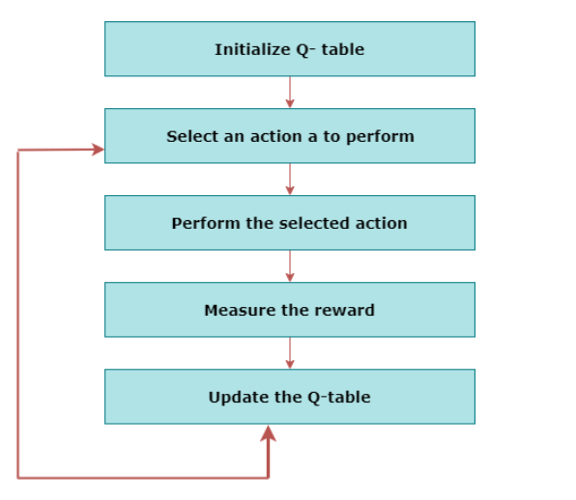

Slide 32
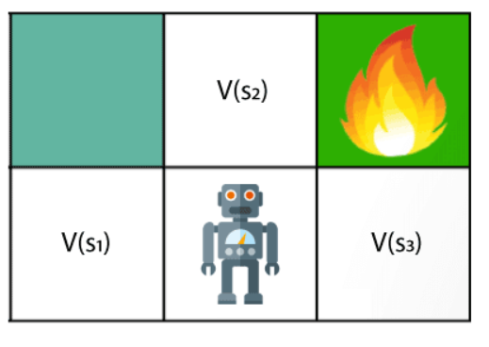
Notes:
https://www.geeksforgeeks.org/monte-carlo-policy-evaluation/

Slide 33
we can see there is an agent who has three values options, V(s₁), V(s₂), V(s₃). As this is MDP, so agent only cares for the current state and the future state.
The agent can go to any direction (Up, Left, or Right), so he needs to decide where to go for the optimal path.
Here agent will take a move as per probability bases and changes the state. But if we want some exact moves, so for this, we need to make some changes in terms of Q-value.

Slide 34
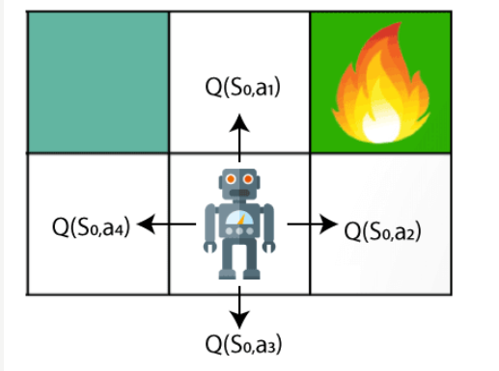

Slide 35
Q- represents the quality of the actions at each state. So instead of using a value at each state, we will use a pair of state and action, i.e., Q(s, a).
Q-value specifies that which action is more lubricative than others, and according to the best Q-value, the agent takes his next move.
The Bellman equation can be used for deriving the Q-value.

Slide 36
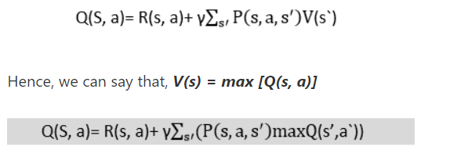
The above formula is used to estimate the Q-values in Q-Learning.

Slide 37

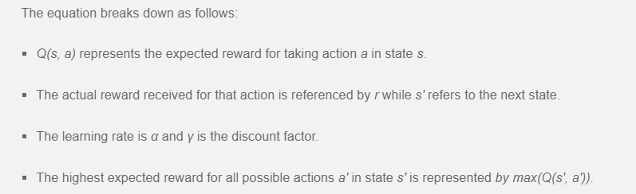

Slide 38
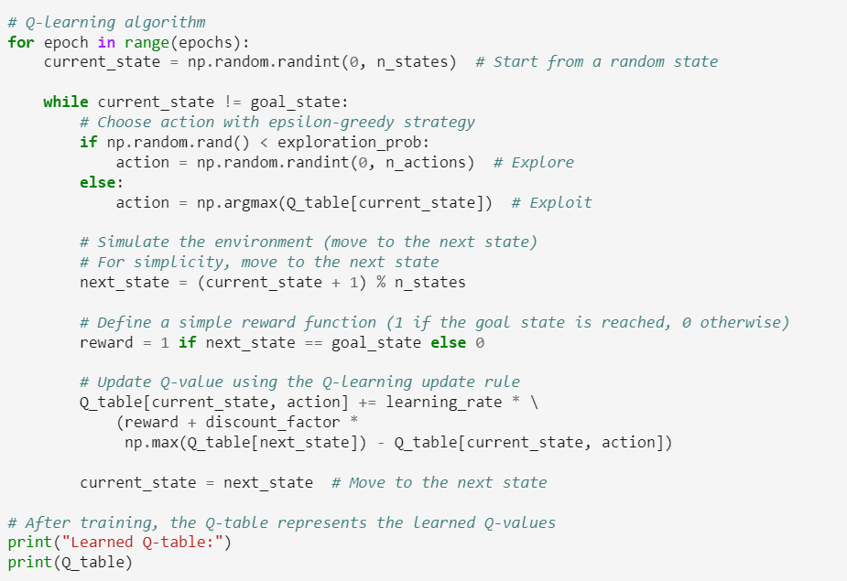
Notes:
Code Reference: https://www.geeksforgeeks.org/q-learning-in-python/

Slide 39
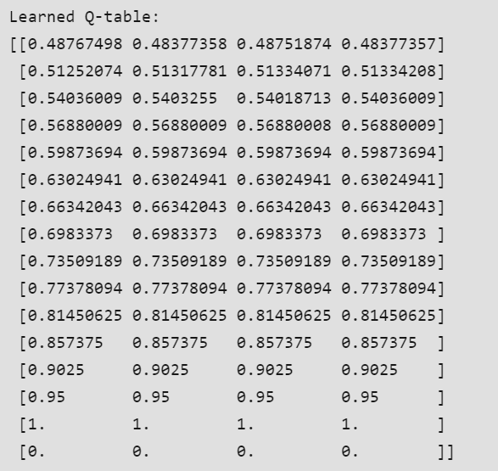

Slide 40
SARSA
State-Action-Reward-State-Action
Consider teaching a computer to play a game, operate a car, or manage resources.
SARSA is a reinforcement learning algorithm that teaches computers how to make good decisions by interacting with an environment.
It helps computers learn from their experiences to determine the best actions.

Slide 41
Explanation of SARSA:
Assume you're teaching a robot to navigate a maze. The robot begins at a specific location (the "State" - where it is), and you want it to discover the best path to the maze's finish.
The robot can proceed in numerous directions at each step (these are the "Actions" - what it does). As it travels, the robot receives input through incentives - positive or negative numbers indicating its performance.

Slide 42
Explanation of SARSA:
The amazing thing about SARSA is that it doesn't need a map of the maze or explicit instructions on what to do.
It learns by trial and error, discovering which actions work best in different situations. This way, SARSA helps computers learn to make decisions in various scenarios, from games to driving cars to managing resources efficiently.

Slide 43
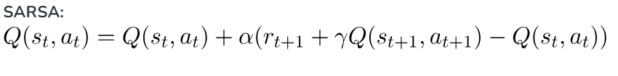
Equation
Here, the update equation for SARSA depends on the current state, current action, reward obtained, next state and next action.

Slide 44
Code Snippet

Slide 45
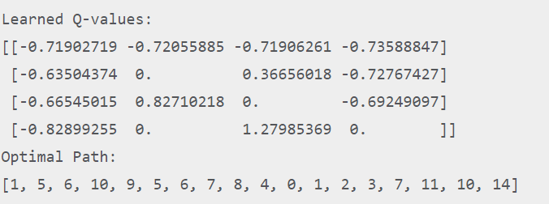
Output

Slide 46
Model Based Reinforcement Learning
The model is used for planning, which means it provides a way to take a course of action by considering all future situations before actually experiencing those situations.
In Model-based reinforcement learning which mimics the behavior of the environment.
The approaches for solving the RL problems with the help of the model are termed as the model-based approach.
With the help of the model, one can make inferences(idea or conclusions) about how the environment will behave.

Slide 47
Such as, if a state and an action are given, then a model can predict the next state and reward.
Model-based reinforcement learning (MBRL) is an approach within the field of reinforcement learning (RL) that incorporates a model of the environment to improve the efficiency and effectiveness of the learning process.

Slide 48
In MBRL, an agent not only learns from interactions with the environment but also builds and utilizes a model of the environment.
This model can predict the next state and reward given the current state and action. It helps the agent to simulate future states and outcomes without direct interaction.

Slide 49
Approach in MBRL
1. Model Learning:
Implicit - Indirectly learning models, often through latent variable representations or embeddings.
Explicit- Directly learning the dynamics of the environment (e.g., using neural networks or Gaussian processes).
2. Planning Algorithms:
Planning involves using the model to simulate multiple future scenarios, enabling the agent to choose actions that maximize long-term rewards.
3. Hybrid Approach
Combining MBRL with model-free methods can leverage the strengths of both approaches.

